Slide 1
Behold Bootstrap!
Day 6
June 24, 2017

Slide 2
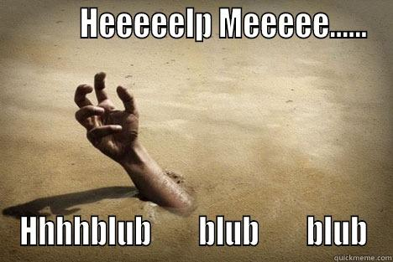

Slide 3


Slide 4


Slide 5


Slide 6
Announcements

Slide 7
Announcements
4th of July Holiday – No class on
Saturday 7/1
Monday 7/3
Tuesday 7/4

Slide 8
Today’s Class

Slide 9
Objectives
Students will use Twitter Bootstrap to create layouts
Students will learn to use media queries for mobile responsive websites
Students will learn to use the viewport tag to make sure all devices are displaying web pages optimally

Slide 10
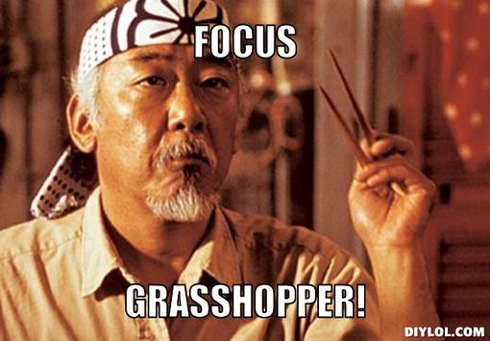
Focus!
This stuff is important…

Slide 11
Recap Bootstrap

Slide 12
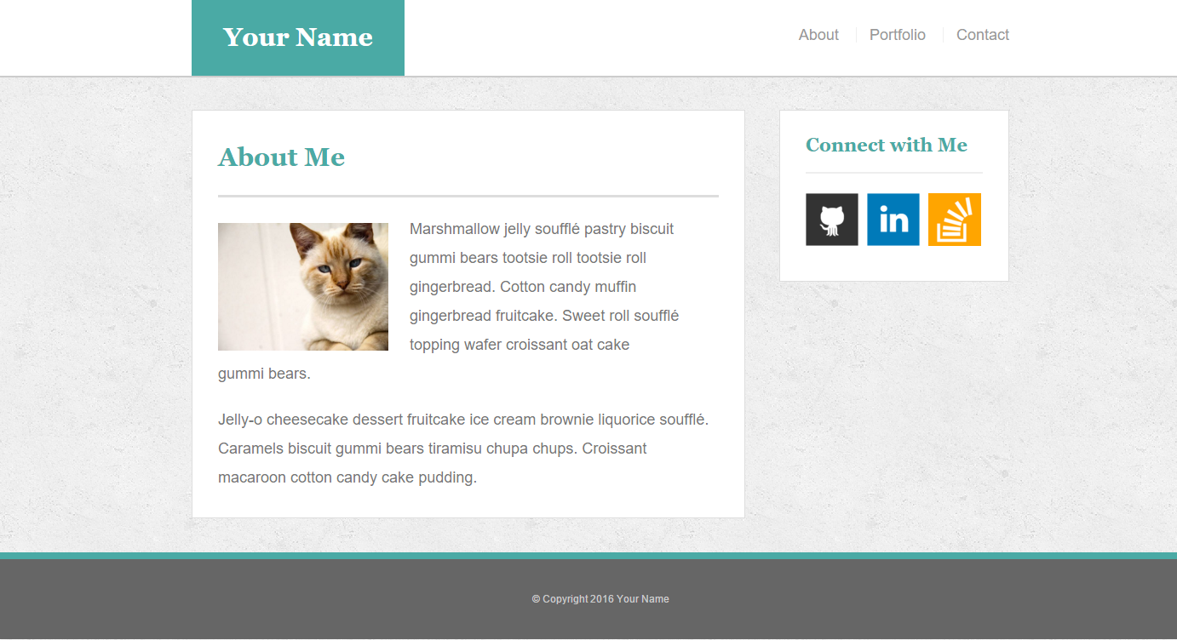
The Pains of HW 1
Plain HTML + CSS makes layout building challenging

Slide 13

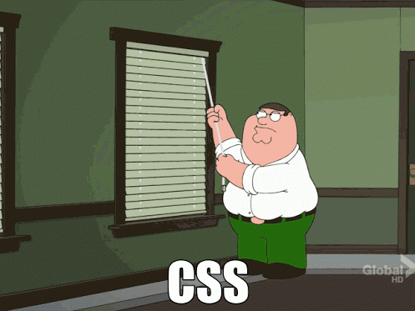
How You (Probably) Feel About CSS

Slide 14


Slide 15
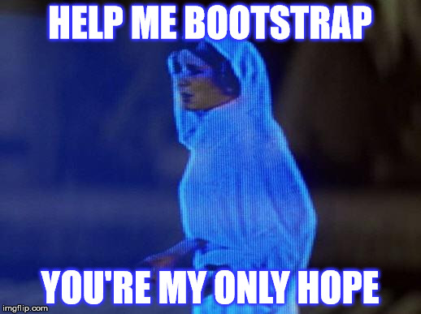
A Revelation…
There is a better way!

Slide 16

Then Came Bootstrap…

Slide 17


Powered by Bootstrap
External CSS Link
Pre-Defined CSS Class (ex: “Jumbotron”)

Slide 18
Powered by Bootstrap
class=“jumbotron”

Slide 19

Big Deal!!!
Using Bootstrap,
we have PRE-DEFINED CSS Styles.

Slide 20

Why Use Bootstrap?
Reason #1: UI Kit
Familiarize yourself with the UI features it offers via the documentation.
Once Bootstrap is active, you can simply copy snippets from the documentation to save yourself major time of creating elements yourself.

Slide 21

Why Use Bootstrap?
Reason #2: Mobile Responsiveness
One of the most compelling reasons to use Bootstrap is the default mobile-responsive quality it provides.
This means that your website will look “good” automatically when viewed on screens ranging from monitors to tablets to phones.

Slide 22
> YOUR TURN!!
Warmup Activity:
As a repeat of last class, quickly create an HTML webpage.
Then add in a Bootstrap component of your choosing.
Hint: Copy the Bootstrap CSS link. Then copy the code from any Bootstrap element or CSS.

Slide 23
Next Phase Bootstrap
Last class, we focused on Bootstrap Components (like buttons and tables).
Today we’ll be focused on using Bootstrap to build layouts.

Slide 24
Sketching / Grid Layouts

Slide 25

Take a Huge Breath…

Slide 26

FOCUS!
Because in our opinion, these next two sections are of the
MOST IMPORTANT ONES
in the ENTIRE program.
Facebook surf at your own peril (and to the peril of the galaxy)

Slide 27
FOCUS!
Relax. That doesn’t mean its hard.

Slide 28
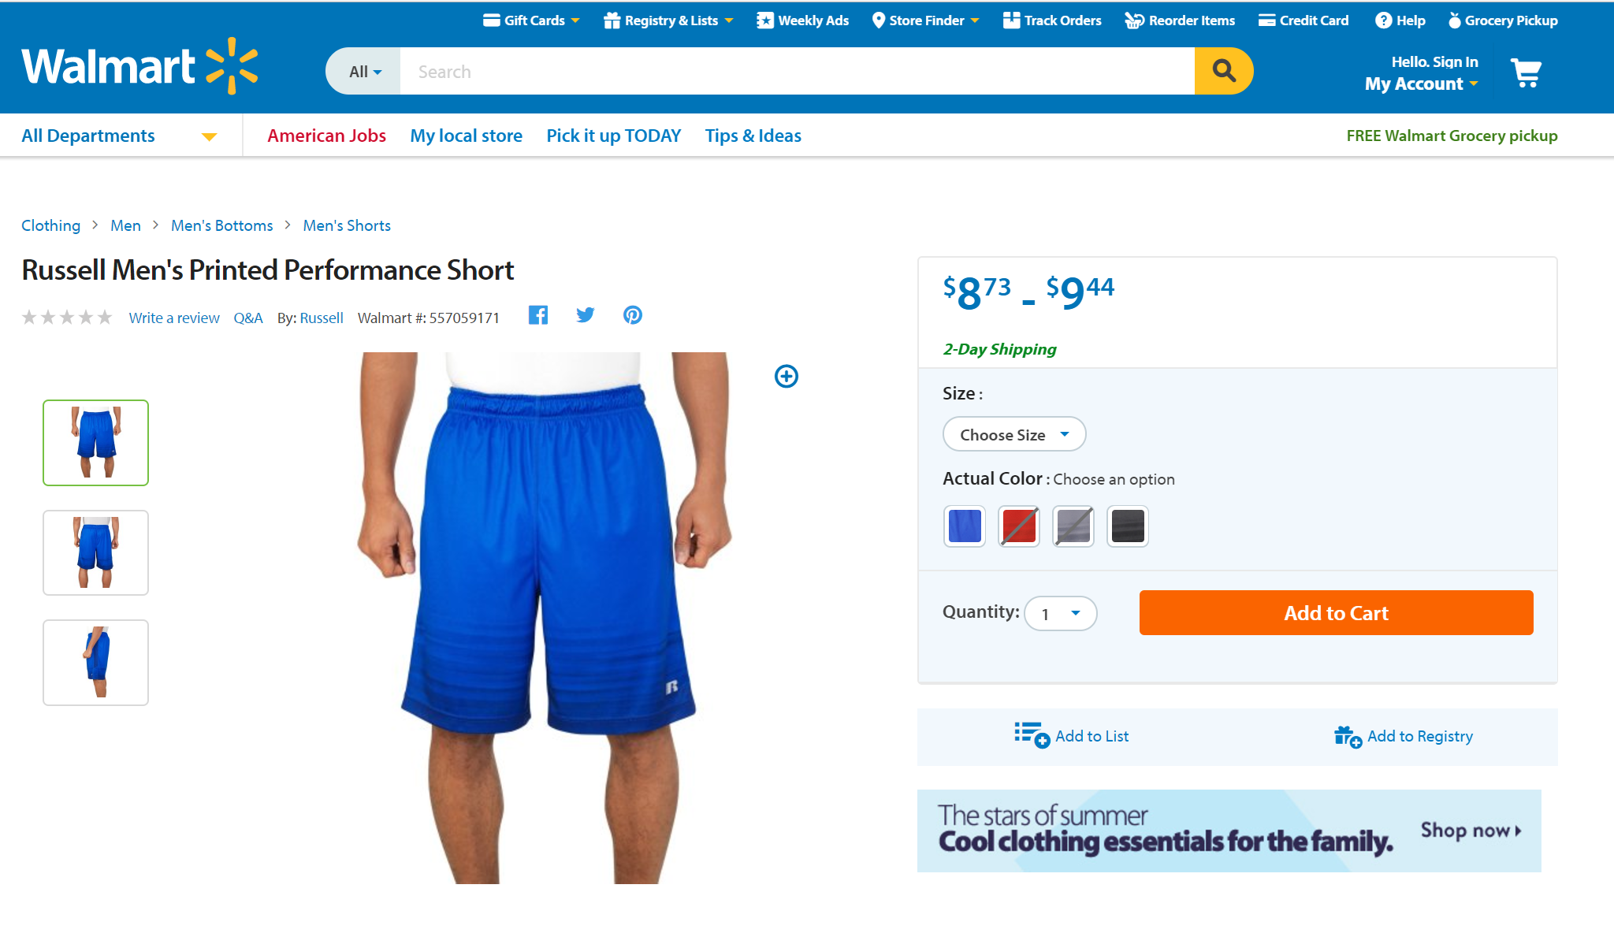
Your job, should you accept it, will be to build sites like this…

Slide 29
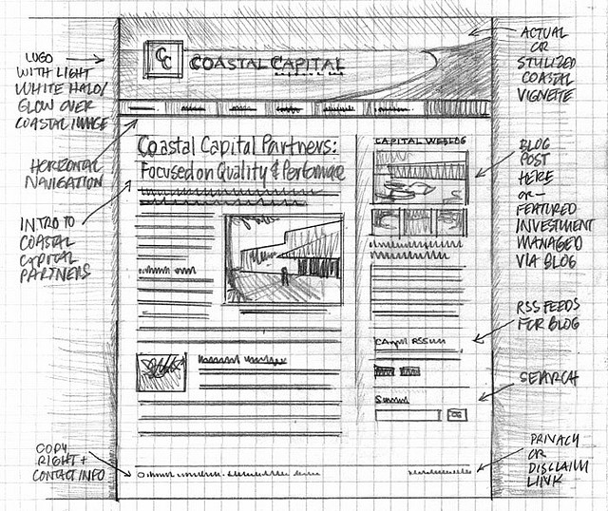
Importance of Sketches
Because every aspect of a site’s “look” is defined by HTML/CSS – it is crucial to have a detailed sketch going in.
Pay particular attention to the location of navigation bars, titles, headers, content, images, footers etc.
When imagining alignments, in particular, be mindful of the grid

Slide 30
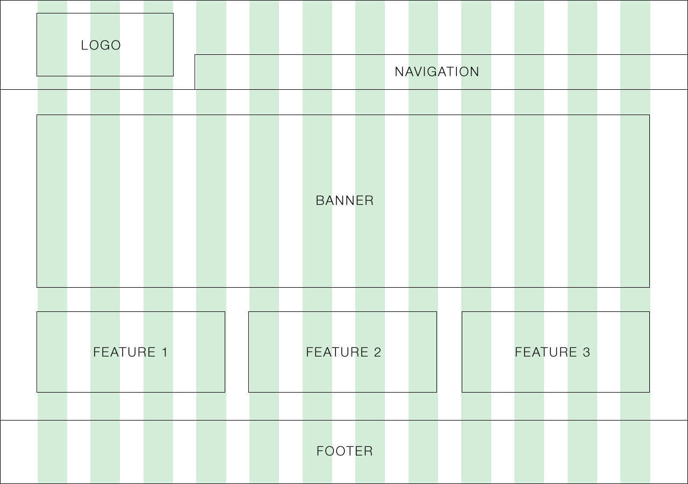
Designing with a Grid in Mind
Grids serve to align elements aesthetically.

Slide 31

Facebook’s Grid
Facebook is a perfect example of a website where the “grid-layout” is obvious.
Grids make it easy to have content (text, images, and regions) align aesthetically.

Slide 32
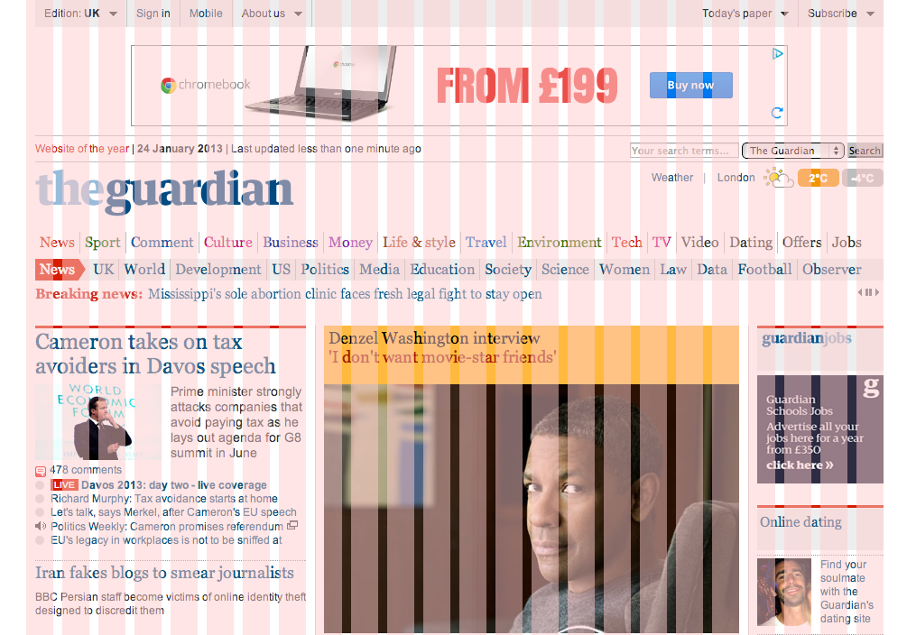
A More Complex Grid…

Slide 33
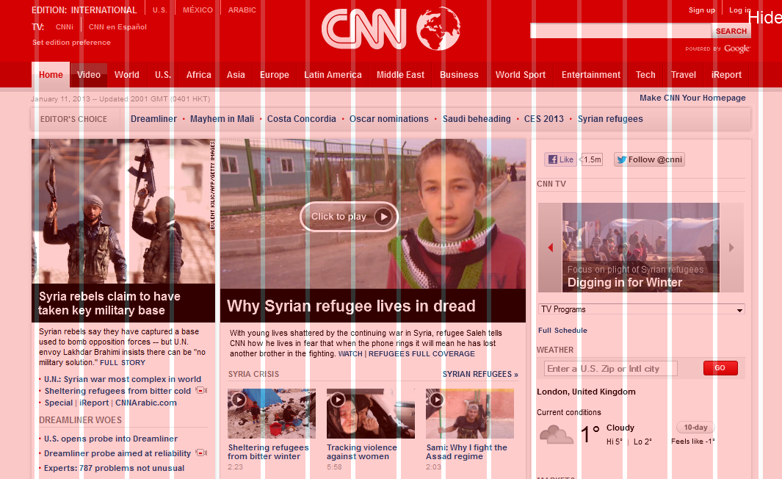
A More Complex Grid…

Slide 34
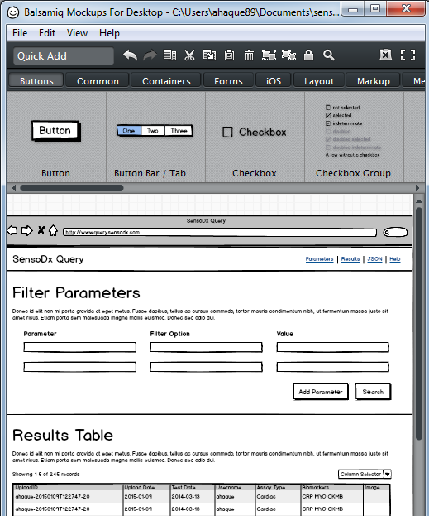
Tools for Sketch / Grid Creation
Wireframing Tools:
Balsamiq: https://balsamiq.com/
Framebox: http://framebox.org/
Draw.io: https://www.draw.io
Pen and Paper: Your notebook
Grids for Photoshop / Illustrator / PDF:
960 GS: http://960.gs/
Designing with Grids Guides:
960 Grid System Made Easy: http://bit.ly/1sjYaFC
Design by Grid: http://www.designbygrid.com/
Designing with Grid-Based Approach: http://bit.ly/1CM4Hzo

Slide 35
Rows and Columns
Workshop

Slide 36
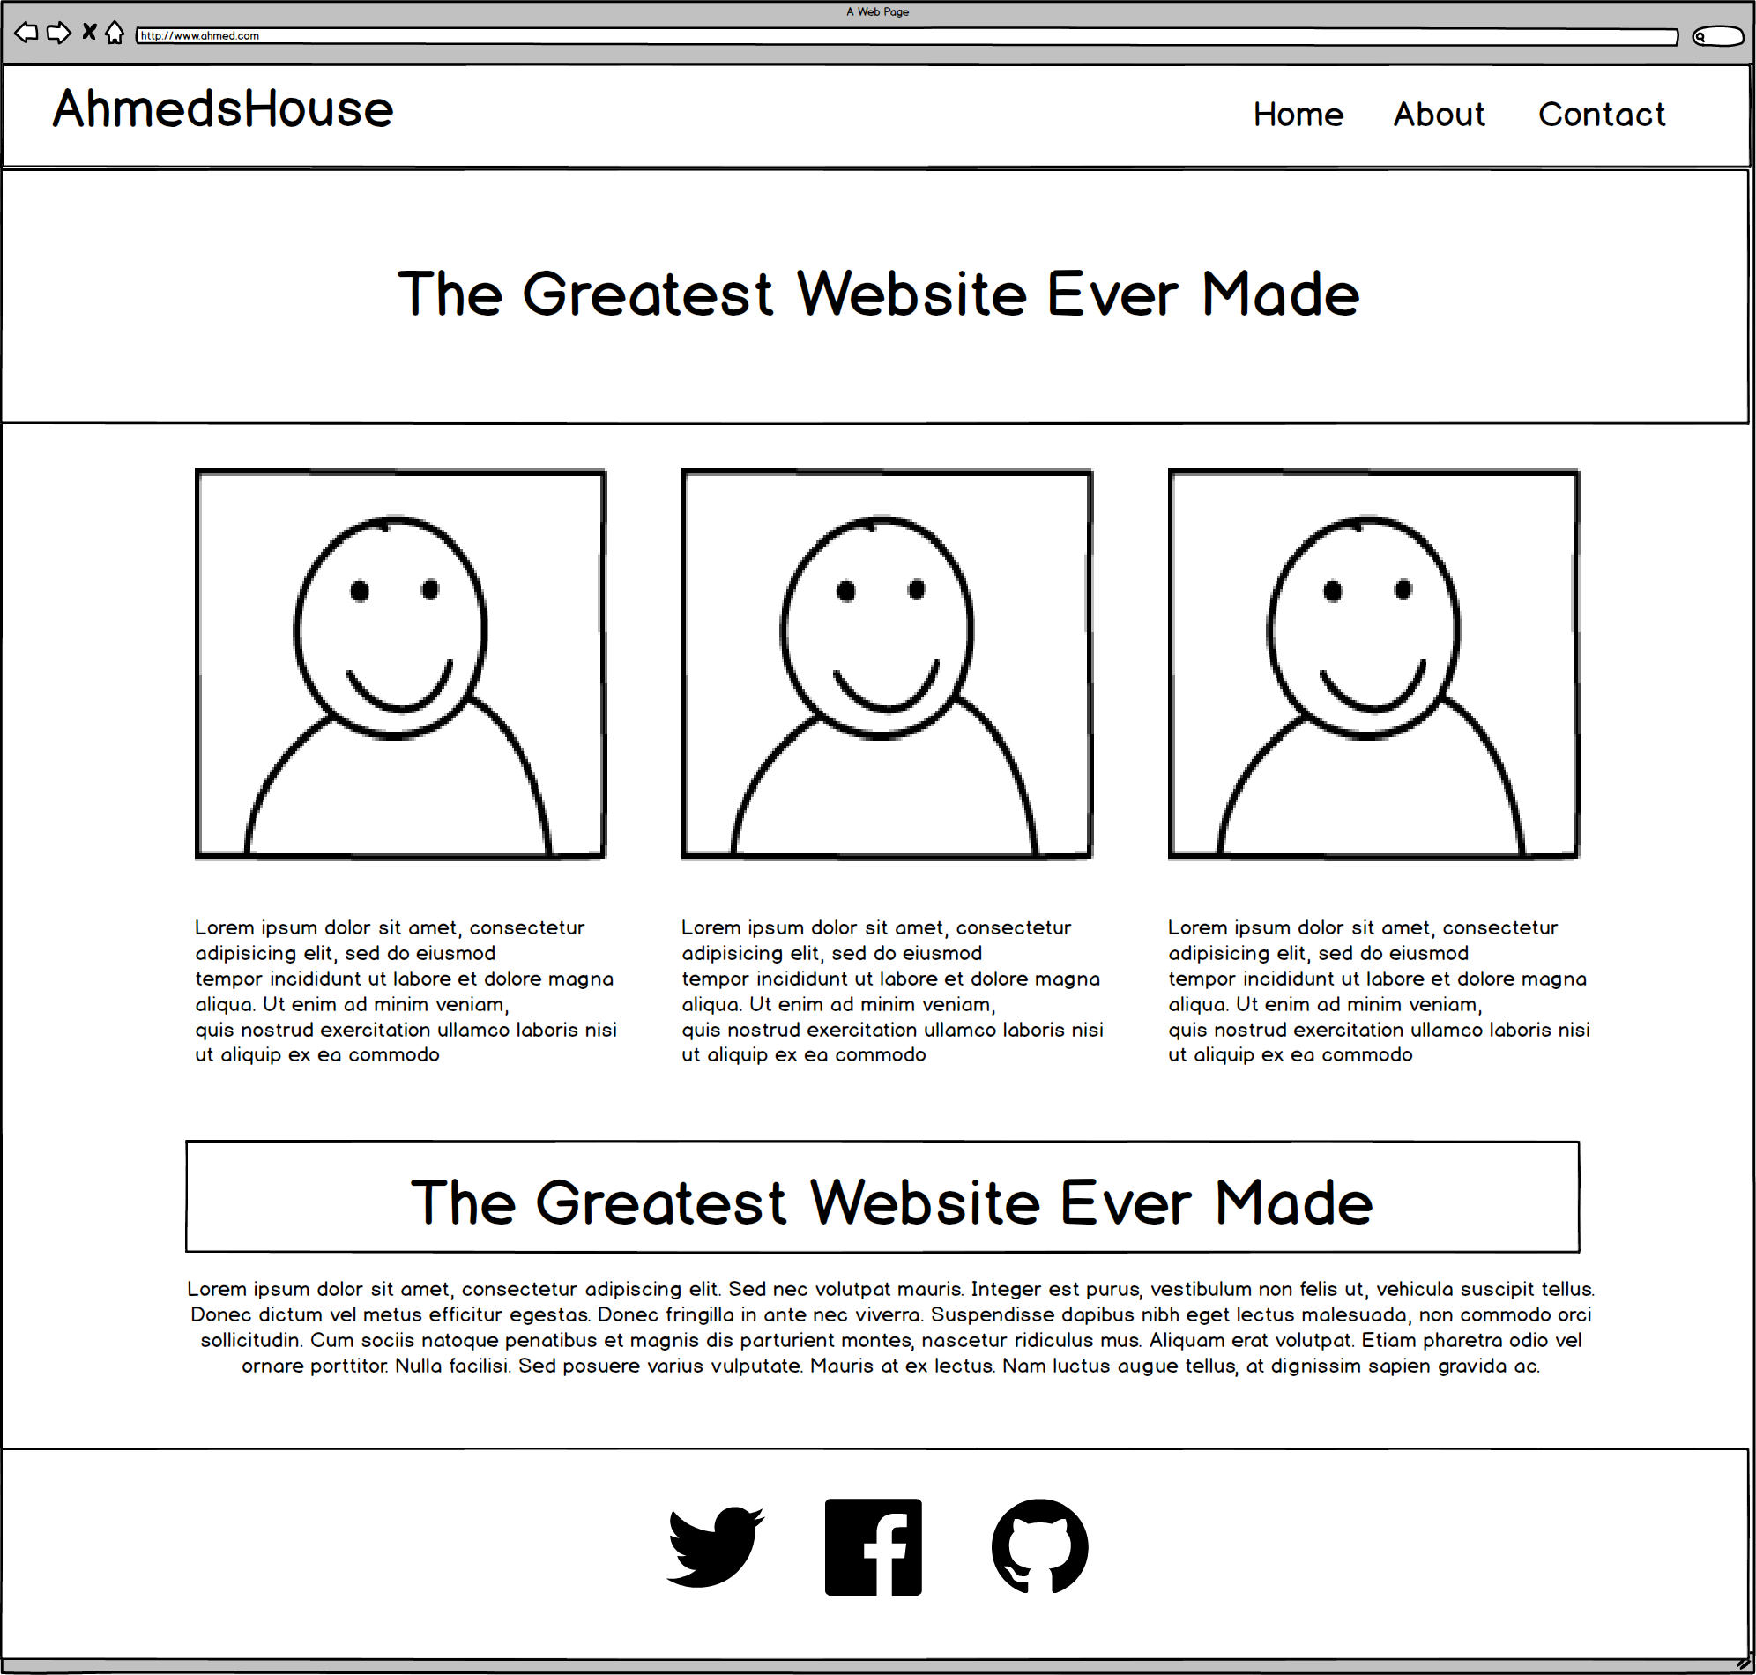
Web pages start as wireframes

Slide 37
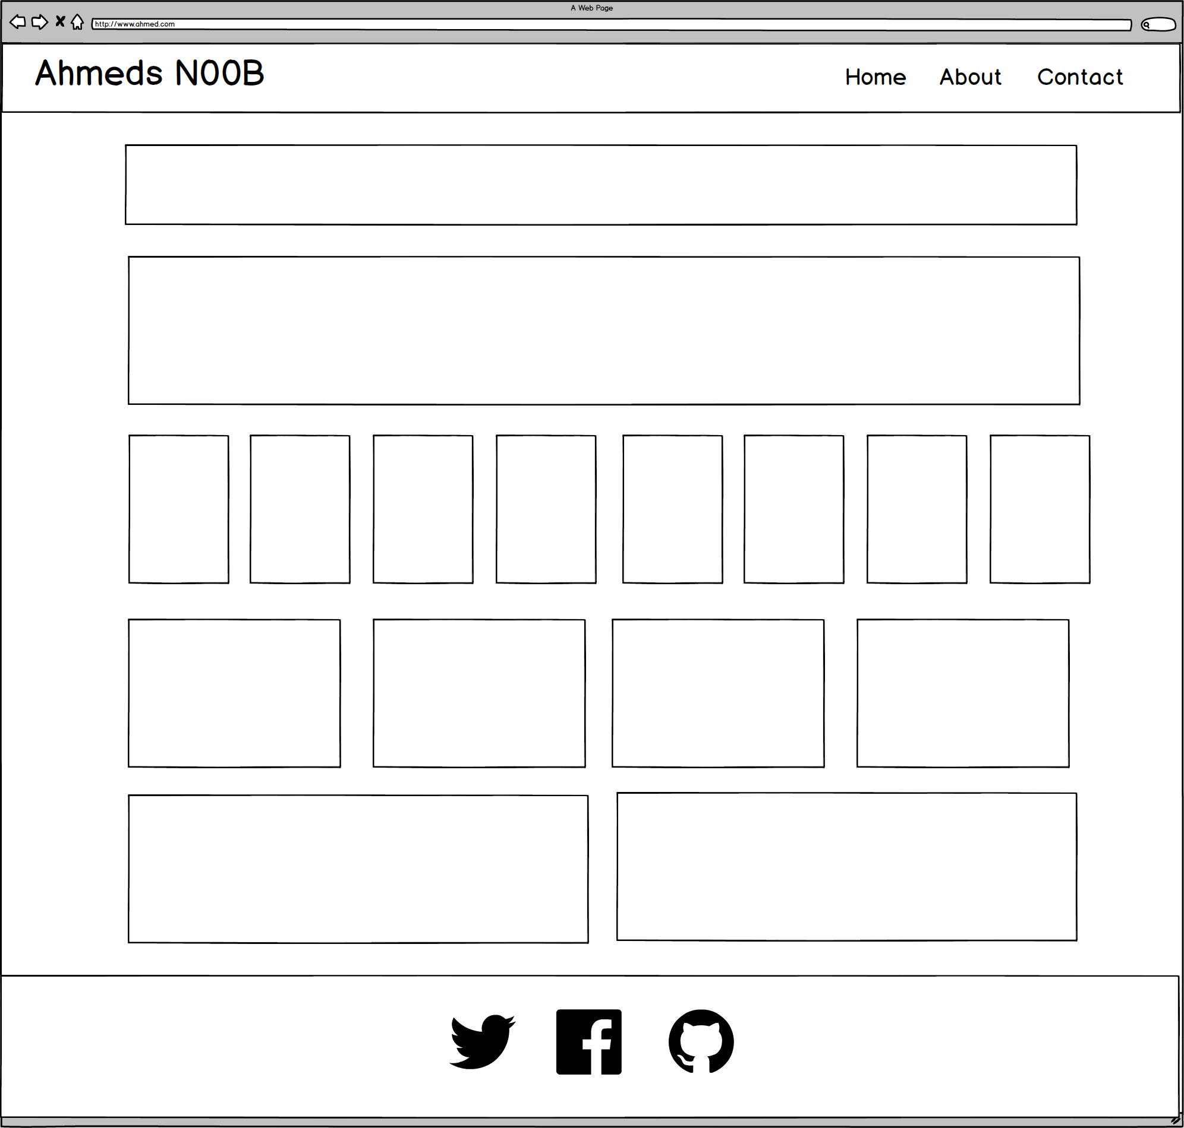
Notes:
7:00 – 7:05

Slide 38
ROWS
1
1
1
1
1
6 Total
1
Notes:
7:00 – 7:05

Slide 39
COLUMNS
1
1
8
4
2
1
Notes:
7:00 – 7:05

Slide 40
Level Up!
Now, let’s make it more challenging…

Slide 41
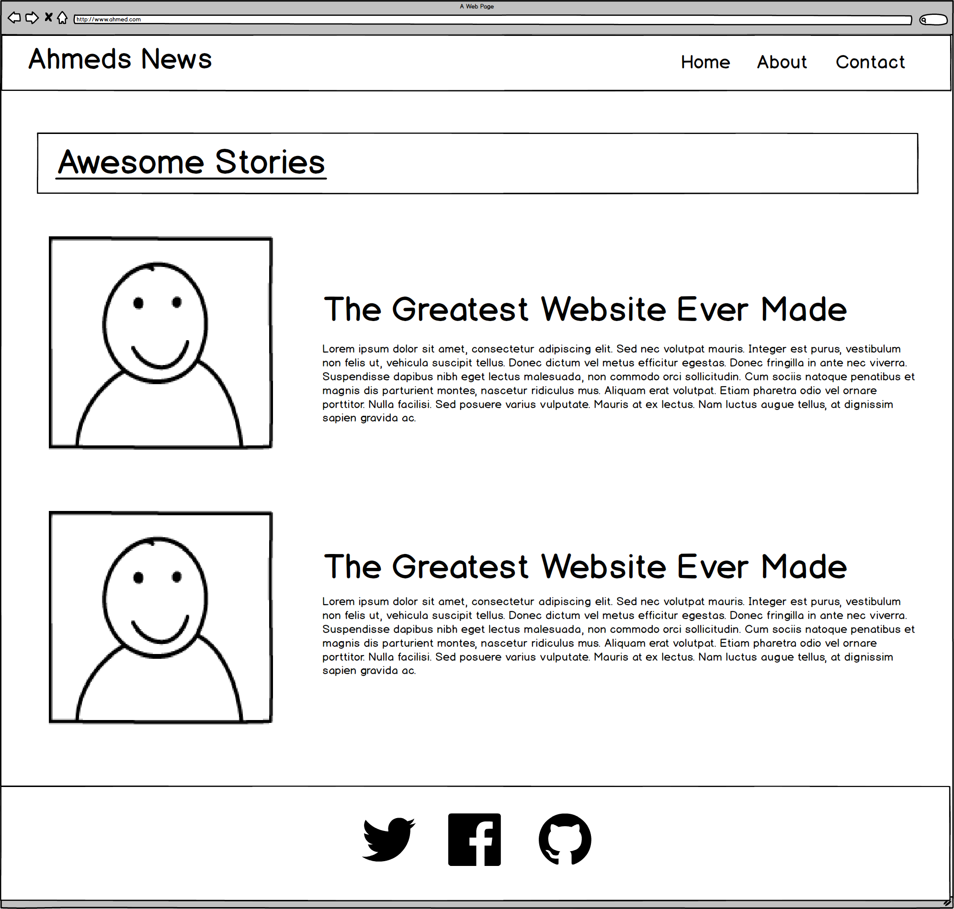
You Try!
Notes:
7:00 – 7:05

Slide 42
ROWS
1
1
1
4
Total
1
Notes:
7:00 – 7:05

Slide 43
COLUMNS
1
2
2
1
Notes:
7:00 – 7:05

Slide 44
Level Up!
Now for another…

Slide 45
You Try!
Notes:
7:00 – 7:05

Slide 46
ROWS
Answer A
1
1
1
4
Total
1
Notes:
7:00 – 7:05

Slide 47
ROWS
Answer B
1
1
1
1
5
Total
1
Notes:
7:00 – 7:05

Slide 48
COLUMNS
1
3
1
1
Notes:
7:00 – 7:05

Slide 49
Level Up!
This final one is tricky…

Slide 50

You Try!
Notes:
7:00 – 7:05

Slide 51
Level Up!
Didn’t quite work right?
For this one we need sub-rows and sub-columns

Slide 52
ROWS
1
1
3
Total
1
Notes:
7:00 – 7:05

Slide 53
COLUMNS
1
2
1
Notes:
7:00 – 7:05

Slide 54
SUB-
ROWS
1
1
1
1
4
Total
Notes:
7:00 – 7:05

Slide 55
SUB-
COLUMNS
2
2
2
1
Notes:
7:00 – 7:05

Slide 56
You Try!
Notes:
7:00 – 7:05

Slide 57
https://www.walmart.com/ip/Russell-Men-s-Printed-Performance-Short/55204432
You Try!
Notes:
7:00 – 7:05

Slide 58
https://www.walmart.com/ip/Russell-Men-s-Printed-Performance-Short/55204432
ROWS
Notes:
7:00 – 7:05

Slide 59
https://www.walmart.com/ip/Russell-Men-s-Printed-Performance-Short/55204432
COLUMNS
Notes:
7:00 – 7:05

Slide 60
SUB-
ROWS
https://www.walmart.com/ip/Russell-Men-s-Printed-Performance-Short/55204432
Notes:
7:00 – 7:05

Slide 61
SUB-
COLUMNS
https://www.walmart.com/ip/Russell-Men-s-Printed-Performance-Short/55204432
Notes:
7:00 – 7:05

Slide 62
SUB-
SUB-ROWS
https://www.walmart.com/ip/Russell-Men-s-Printed-Performance-Short/55204432
Notes:
7:00 – 7:05

Slide 63
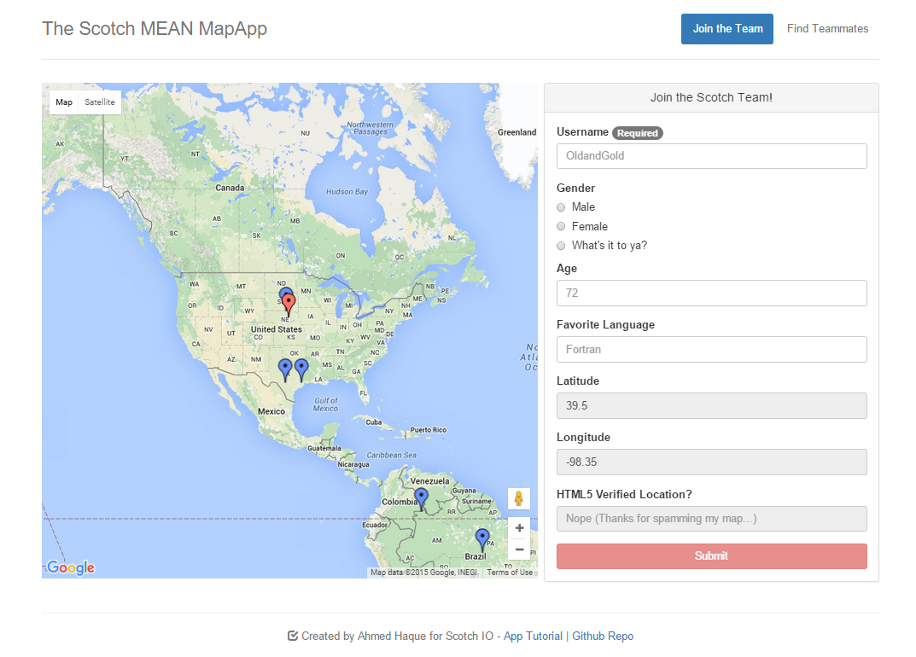
Notes:
7:00 – 7:05

Slide 64
ROWS
1
1
Notes:
7:00 – 7:05

Slide 65
COLUMNS
2
1
Notes:
7:00 – 7:05

Slide 66

Notes:
7:00 – 7:05

Slide 67
Grid Design with Bootstrap

Slide 68
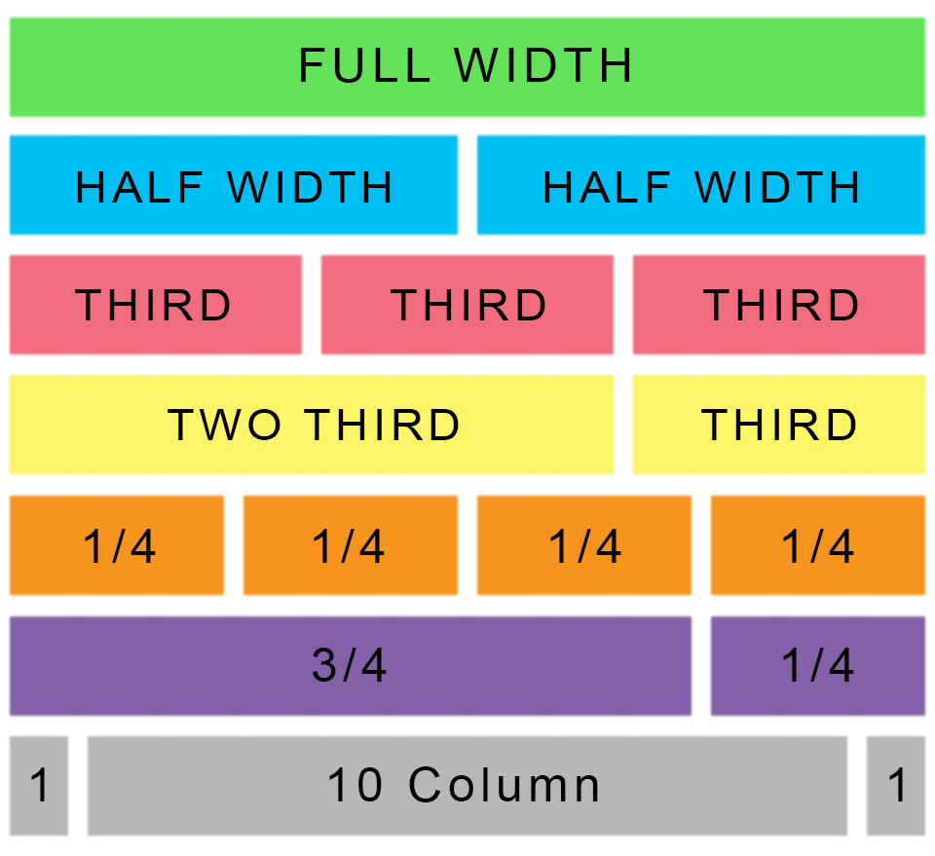
Bootstrap Grid
Bootstrap lets you organize content based on the “number of columns” a div spans – out of a total 12 columns
Example:
<div class="col-md-12">
(Spans full width)
<div class="col-md-4">
(Spans 1/3 of full width)

Slide 69
Bootstrap Grids
Every Bootstrap Grid is made up of…
containers – which wrap around the entire grid
rows – which are defined first and are just rows
columns – which are defined within rows and specify the columns
Each of these elements is implemented by creating a div with a specific class name.

Slide 70
Bootstrap Grids
Container
Row #1
Column#1
Column#2
Column#3
Row #2
Column#1
Column#2
…

Slide 71
Bootstrap Grids – syntax
<div class="container">
<div class="row">
<div class="col-md-4">
<div class="col-md-4">
<div class="col-md-4">
<div class="row">
<div class="col-md-6">
<div class="col-md-6">
“Columns” fit inside of rows. Note the syntax: col-sz-#
col column
sz viewing size (in this case: medium)
# number of “columns taken” out of 12 (in this case 6 of 12)
…

Slide 72
Bootstrap Grids – sub-rows and sub-columns
Rule 1: Columns must always go inside a row
<div class="container">
<div class="row">
Rule 2: Rows must always go inside a container or a column
<div class="col-md-8">
<div class="col-md-4">
<div class="row">
<div class="col-md-6">
<div class="col-md-6">
Rule 3: Text / buttons / components always go inside a column
<div class="row">
<div class="col-md-12">

Slide 73
> YOUR TURN!!
Quick Activity:
Turn to your neighbors and explain to one another:
The relationship between containers, rows, and columns. (Draw it on a piece of paper for them)
The syntax for each.
The specific syntax details for columns.

Slide 74
Coding Grids

Slide 75
INSTRUCTOR DEMO!
Instructor: Demo
(quickgrid.html | 2-InstructorGrids)

Slide 76

Bootstrap Grid
Note the rows, columns (col-lg-6), and containers

Slide 77

Bootstrap Grid
Note the rows, columns (col-lg-6), and containers

Slide 78

Defining Containers
“Containers” are like the box that the entire grid sits inside.

Slide 79

Defining Rows
“Rows” are like the rows we talked about earlier.

Slide 80

Defining Columns
“Columns” fit inside of rows. Note the syntax: col-sz-#
col = column
sz = viewing size (in this case: medium)
# = number of “columns taken” out of 12. (in this case 4 of 12)

Slide 81
> YOUR TURN!!
Activity:
Using Twitter bootstrap, create a layout that looks like the one shown on the next screen.
Spend some time prior to coding to draw out the grid layout
Count the number of rows and columns
Then use the bootstrap grid syntax to code it out.
Slack a screenshot of your page when you are done.
Ipsum Generator: http://www.lipsum.com/

Slide 82

> YOUR TURN!!

Slide 83
Lunch Break

Slide 84
Building Bootstrap Layouts

Slide 85
INSTRUCTOR DEMO!
Instructor: Demo
(InClass-DemoLayout.html | 4-InstructorLayout)

Slide 86
> YOUR TURN!!
Activity:
Working in pairs and using Twitter Bootstrap make the following design.
Be sure to note the:
Grid Layout
Navbar
Sidebar panel
Thumbnail
Additional details will be sent to you via slack.

Slide 87
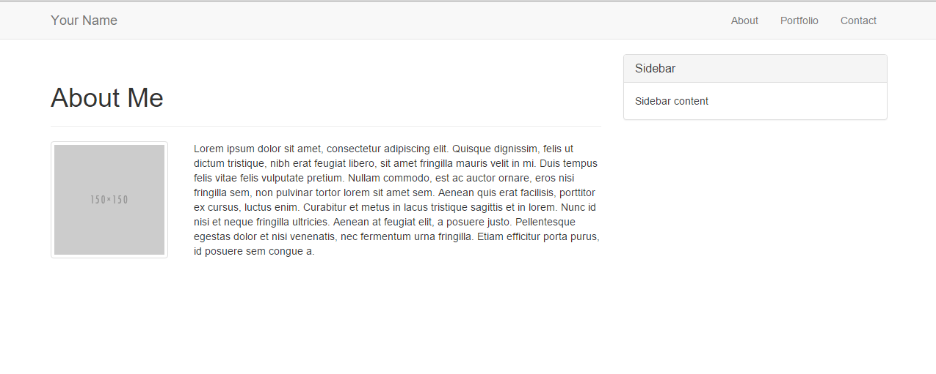
> YOUR TURN!!

Slide 88
Common Questions
Can I put a column directly inside a container or another column? No. Columns always go inside of rows. Start with 1 row inside the container/column, and then put your columns inside that.
Can I just avoid having a container? You could… But it will mess things up. Just throw in a container.
What if I have columns that go past 12? Extra columns will wrap onto a new line
What if I don’t add up to 12? Nothing. You will have empty space at the end

Slide 90
Mobile Responsive (HW)

Slide 91

Still No Facebook Time
Warning!
This next section matters a lot for your homework

Slide 92
Media Queries
Media Queries define how CSS styles are applied in relation to the characteristics of the viewing device.
Through media queries we can change the way a webpage is displayed based on width, height, orientation, and even resolution.
Bootstrap extensively uses media queries to help you create mobile responsive websites.
But remember! Media queries must be declared last.

Slide 93
INSTRUCTOR DEMO!
Instructor: Demo
(17-InstructorMedia)

Slide 94
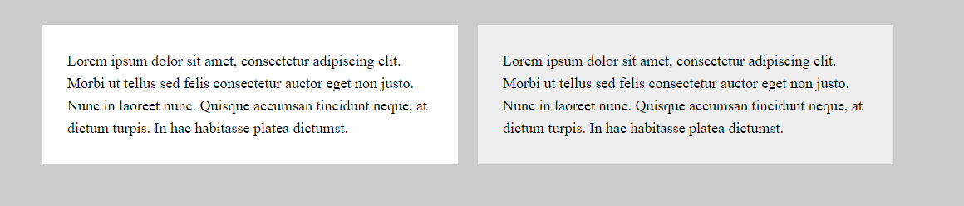
Quick Demo

Slide 95
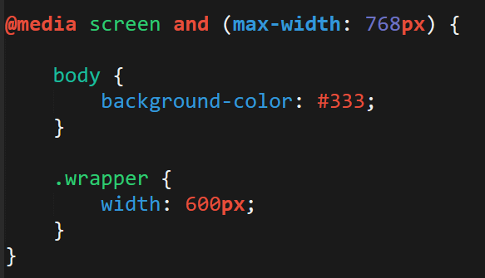
> YOUR TURN!!
Activity:
Explain to your partner what the following CSS code does:

Slide 96
> YOUR TURN!!
Activity:
Build your own mobile responsive HTML /CSS page using media queries.
Just follow the steps sent to you via Slack.

Slide 97
Viewport
Viewport is the user’s visible area of a webpage.
Viewport controls how a webpage is displayed on a mobile device. Without this, mobile devices would render the page at a typical desktop screen (scaled down).

Slide 98


Viewport
No Viewport
Yes Viewport

Slide 99
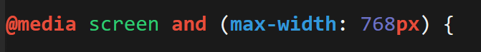
Viewport Inclusion
Just include this line in the head
And then include a variety of @media queries for various sized screens.

Slide 100
> YOUR TURN!!
Activity:
Spend the next few moments using the device emulator in Chrome developer tools and visit your favorite websites using various viewports.
Notice how the sites change display wise.

Slide 101
Questions?

Slide 102
Extra Challenge
Time Permitting

Slide 103
> YOUR TURN!!
Activity:
With those around you (and using Twiiter Bootstrap), create a complex layout of your own.
You can use the layout provided to you as a guide, starting point, inspiration, or not at all.

Slide 104
